Slide 1

CodeCompass
CSE-115a Fall 2025
By:
Nickolas, Hao, Stephen, Vincent
Product Owner:
Mann
Initial SCRUM Master:
Evan

Slide 2
The Problem
It takes hours to get up to speed on a new codebase.
New employees spend months familiarizing themselves with complex company codebases before making meaningful contributions. This process burns time for both:
New hires – struggling with poor documentation and tutorials.
Senior developers – who must repeatedly explain mundane details instead of focusing on their own critical tasks.

Slide 3
🚨 The Problem with Current Solutions
Existing Codebase Question-Answering Platforms and AI-Powered Codebase Documentation Generators (e.g., DeepWiki) promise to help developers understand large codebases.
But such solutions fall short in critical ways:
🔒 Privacy Concerns – They are hosted on third-party servers, requiring you to upload proprietary code to external systems — a dealbreaker for many companies. Enterprises often can’t use cloud GitHub at all. They’re required to keep code in on-premises
🔗 Limited Integrations – Most only support GitHub repositories, leaving out enterprises that rely on GitLab, Bitbucket, Azure DevOps, Mercurial, or other self-hosted solutions.
🤖 Locked to Proprietary LLMs – Users have no control over which model powers their assistant. Some models excel at reasoning, others at code generation or chat — but you’re stuck with whatever the vendor chose.
🚫 No Self-Hosting Option – Without on-premise deployment, companies lose control over their workflows, security, and compliance requirements.

Slide 4
What is CodeCompass?
Index any codebase and interact with it through a RAG-powered chatbot.
Automatic AI generated documentation
Supports multiple codebase sources – not just GitHub.
Deploy locally or on the web:
Locally hosted version – run entirely on your own infrastructure for full security and compliance.
A web hosted version which will accept GitHub repos or GitLab Projects (and more)
Completely open source – transparent and customizable.

Slide 5
What Makes CodeCompass Different
Unlike other solutions, CodeCompass won't be limited to Git repos only. It will support a wide range of project codebase sources:
Cloud Platforms: GitHub, GitLab, Bitbucket
Self-Hosted Systems: GitLab (self-hosted), Mercurial
Enterprise Cloud Solutions: GitHub Enterprise, Azure DevOps
CodeCompass could be deployed on the Web or locally. Something DeepWiki will never be able to do.

Slide 6
Sprint 1- Layout Foundation
User Stories
Goal: A Basic RAG Backend
As a user, I want to be able to choose my choice of LLM model so I can make use of the advantages associated with different models.
As a user, I want the chat responses to be relevant to my queries and my codebase.
Goal: Set up a chat interface
As a user, I want a chat interface where I can input a question and receive a response so I can make inquiries about my codebase.
As a user, I want to be able to view the files(and lines of code) that the LLM is using to answer my query, so that I know it’s not hallucinating.
Goal: Basic Codebase upload
As a new user, I want to upload my local codebase to start chatting with it.
As a new user, I want a self-hosted instance so that I can use CodeCompass.
Goal: User Management
As a new user, I want to sign up with an email/password so that I can access CodeCompass.
As a new user, I want to create a new organization so that I can invite other users to chat with my Indexed codebases.

Slide 7
Sprint 1
Spikes:
Understand the terminology and concepts related to neural networks
Learn how to do RAG on code files(little different to doing RAG on plain text?)
Infrastructure Tasks:
Setup version control (GitHub)
Initialize Next.js app
Initialize FastAPI backend
Configure the following in Supabase:
Postgres Database Schema
RLS Policies
Authentication + Verification

Slide 8
Sprint 2- more features!
User Stories:
Goal: More RAG/AI Functionality
As a user, I want automatically generated documentation so that me or anyone else can understand the codebase.
Goal: Chat interface Improvements
As a user, I want the LLM response to be streamed as each new token is generated.
Goal: Uploading codebases from other sources
As an open-source developer, I want to upload a public repository from GitHub so I can better understand its structure to make meaningful contributions.
As a user, I want to upload multiple codebases so that I can work on multiple projects simultaneously.
Spikes:
Learn how to generate AI documentation for a very large amount of code that cannot all fit in the LLM context window.

Slide 9
Sprint 3- Iteration
User Stories:
Goal: More RAG/AI Functionality
As a user, I want the LLM responses to be as relevant as possible.
As a user, I want to access chats for older indexes of the project so I can interact with past versions of my codebase.
Goal: Uploading codebases from other sources
As a developer whose codebase is located remotely on GitHub, I want to upload my private codebase to CodeCompass so I can interact with it through CodeCompass’s interface.
Goal: Web Hosting
As a user, I want a web-hosted instance so that I can use CodeCompass without installing anything.
Goal: Self Hosting
As a user, I want to be able to self-host an instance of CodeCompass(along with a user guide on how to self-host) so that I can use it with no concerns about data privacy.
Spikes:
Learn different techniques to improve RAG pipelines accuracy.
Learn how to take codebase input from GitHub.

Slide 10
Sprint 4
User Stories:
Goal: More RAG/AI Functionality
As a user, I want the AI’s response to include generated tree diagrams so I can have a visual representation of a codebases’ different components and how they relate to each other.
Goal: Uploading codebases from other sources
As a user whose codebase is located remotely on GitHub, I want to upload my private codebase to CodeCompass.
As a user, I want to upload repos from GitLab, Bitbucket & Mercurial so I can interact with my code base no matter which tool is used to store it
Goal: Customizable UI
As a user, I want to be able to resize, minimize, & change placement of the different components(Chat window, Relevant Code, AI documentation) on the screen.
Spikes:
Learn what libraries help generate wireframe diagrams and how to represent a projects architecture accurately with said diagram.
Learn how to maintain privacy if user wants to upload private repos from GitHub.

Slide 11
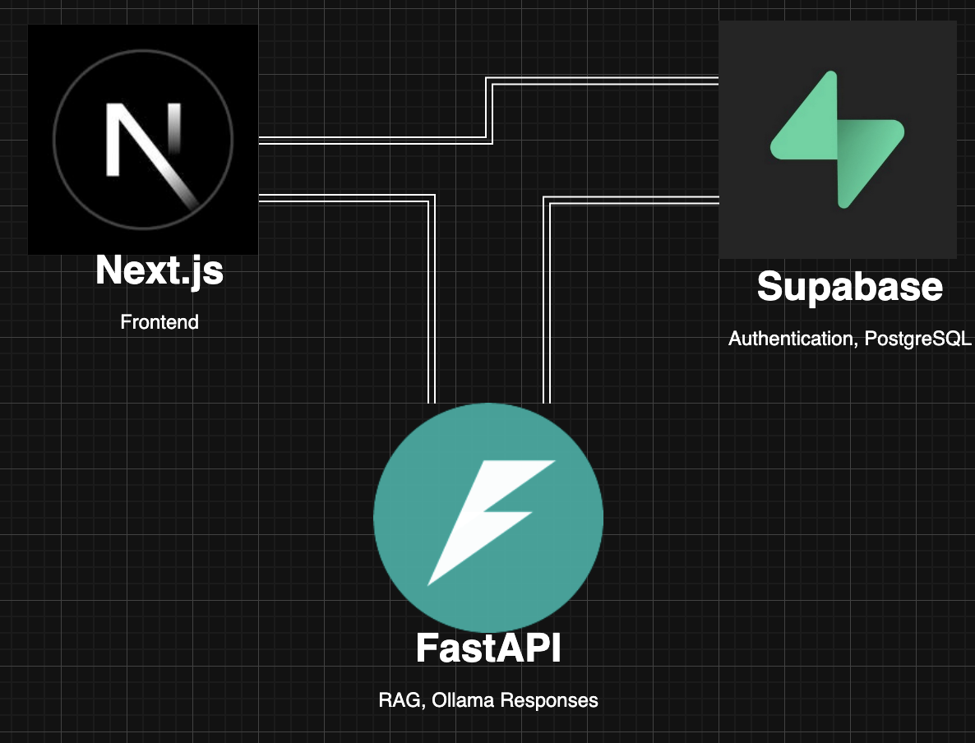
Architecture

Slide 12




Technologies (Frontend/Full-stack)
Typescript
Next.js + Tailwind CSS
shadcn/ui components
Supabase

Slide 13
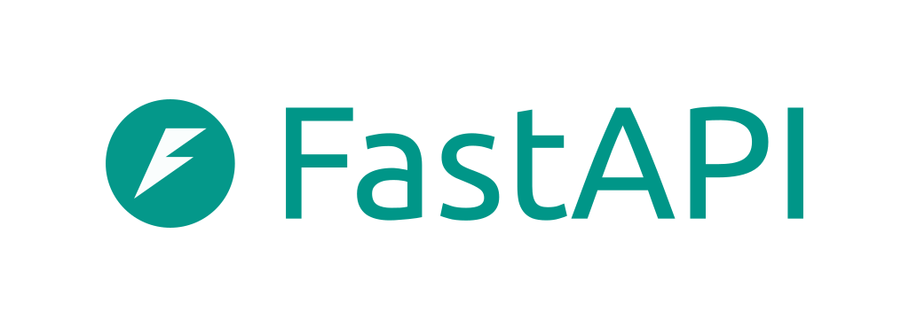

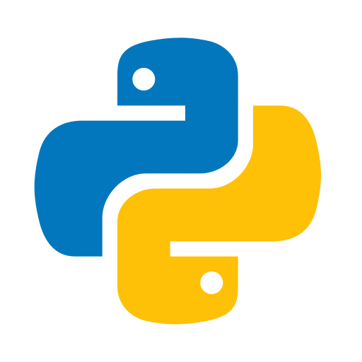

Technologies (Backend)
Python
FastAPI
Ollama
LangChain

Slide 14

⚠️ Challenges / Risks !
High Computational Requirements:
Running powerful LLMs locally requires a strong GPU and large memory capacity.
Hosting inference on services, Eg: RunPod or other GPU cloud providers incurs significant ongoing costs.
Challenges with improving RAG accuracy:
Maintaining relevance and minimizing hallucinations is challenging, especially for large or unstructured codebases
This will require additional research and experimentation, as our backend team currently lacks all the experience needed to implement a production grade RAG pipeline.

Slide 15
Minimum Viable Product
Full-Stack Foundation:
Web + local deployability
Multi-user authentication and session handling
Dashboard to view user projects
Codebase Upload
Upload codebase from Github, GitLab or local files
💬 RAG Chatbot
Chat interface to query the codebase
Display of relevant code snippets
📝 AI Documentation
Automatic documentation generation for each indexed codebase
Architecture overview (e.g., dependency graph summary)
README like overview page

